Slide 1
| One Commercial Partner
Azure Virtual Workshop: IoT Track
Partner Train-the-Trainer Session November 2020
Diana Phillips Senior Cloud Solution Architect US OCP Technical Team, Scale Enablement

Slide 2
Agenda
Program Overview and Goals
Content Review and Hands-on Labs
Logistics and Demand Generation
Communications and Registration
Virtual Event Best Practices

Slide 3
Session Objective To share the IoT Virtual Workshop content with you to partner with you to deliver it to our customers and drive joint engagements

Slide 4

What is an Azure IoT Virtual Workshop?
Azure Immersion Workshop (AIW) – Partner-delivered customer event for business and technical roles from all organizations.
Azure IoT Virtual Workshop (AVW) – One of the AIW Pilot Tracks. During the delivery, customers gain an understanding of the value IoT could bring to their business, learn about example scenarios, see IoT solution demonstrations, and get hands-on with Azure IoT services.
Why a IoT Virtual Workshop?
Drive and accelerate IoT pipeline opportunities
Cater to customer demand for IoT scenarios through a trusted partner ecosystem
Equip co-sell prioritized partners with tools to conduct IoT Virtual Workshops for customers
Get customers hands-on with our Azure IoT technology
Asset Guidance
Guidance on how to use the materials provided on the IoT Virtual Workshop web page
Included: IoT Virtual Workshop agenda, business content, technical content, marketing material, training resources
https://aka.ms/IoT-AVW

Slide 5








FY21 Q2+ Azure Virtual Workshop Program
Azure Immersion Workshop (AIW) Pilot Tracks: A collection of targeted, sales play aligned, third party digital events that are designed to showcase technology and inspire usage via hands on experience instructed by partners at scale.
Event Catalog
Event Structure
Internet of Things (IoT)
Devops with GitHub
Hybrid Cloud Solutions
Open Source on Azure
Cloud Adoption Framework (CAF)
1-Day Live Digital Delivery
4-6-hour event including instructor led presentation followed by hands on guided lab experience; 10 minutes breaks included
Speakers
partner speaker who leads presentation and HOL
FY21 Volume Forecast
~ 1.3K Events Count (WIP)
Corp provided guidance by segment/by Area across A14
~65K Attendee Count (WIP)
~15 customers/ event (up to 50 reg)
Corp Provided Resources
Audience + Demand Gen
Event Design
Bill of Materials
Marketing BOM
Workshop session decks and train the trainer resources
Hands on Labs & Guidance
List of activated partner speaker candidates by event type, by geo
Speaker & Lab Funding
Operational Design & Execution Readiness
Partner Led Demand Generation of ITDM, Dev DM and Architects in Majors, SMC-C and top unmanaged SMB.
Corp PMO supported Event Design to land an enhanced customer experience:
Gated registration (EventBuilder)
Two-way audio capability (Teams)
Live captioning via PPT translator
Hands on lab (Spektra)
PII Lead sharing for Optin-In Customers
Self-Service lead Capturing by sales teams
Post event survey
Post event CTAs
Service Level ACR, ACA and Engagement Influence insights
Partner Led
Partner Led Demand Generation
Personalized
Account team led invitation follow up

Slide 6

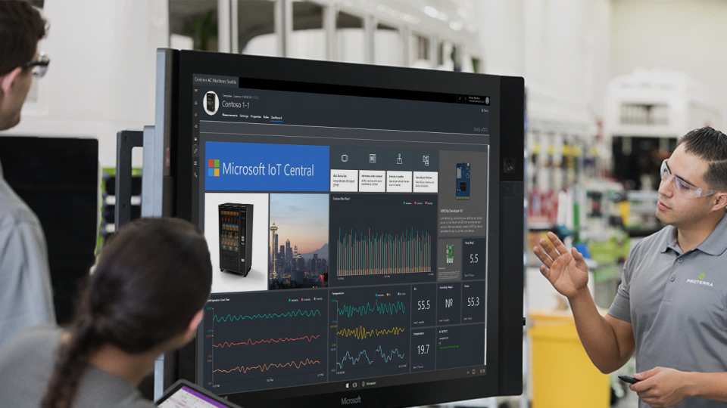
Why Host an IoT Virtual Workshop?
Tackle the most common obstacle for investing in IoT: Complexity
Change customer perceptions…
From…
To…
Setup and integration is time-consuming
I don’t have the skillsets needed in-house
IoT isn’t realistic for businesses like mine
IoT is a daunting, lengthy undertaking
If I can do all this in a day, it must be easier than I thought
I have a clear vision of how my business can use IoT and where to start
The timelines and next steps for implementation are realistic
…in just one day
Notes:
Goal for Partner Hosted IoT In a Day: Show your customers how realistic it is for them to incorporate IoT into their business to alleviate concerns with adopting IoT.

Slide 7




Partner Benefits and Engagement
Partner Benefits
Partner Engagement
Participation in the facilitation of these events provides partners with the unique opportunity to promote themselves and their solution(s) to a set of Microsoft customers they normally wouldn’t be able to reach.
In Scope:
Speaker Payment - $1K per event
OCP partner incentives bucket for majors
C3 funds for SMC
Logo usage with session intro slide
Opportunity to provide a pre-approved offer session in the agenda
Out of Scope:
Co-branding on invite and registration page
Post event communication with partner offer
Partners agree not to contact customers unless the customer has opted-in to be contacted by them
Partner Recruitment
Should meet eligibility criteria
Partners choose their event dates from workshop event calendar – bi-annually
Partner will receive an Activation Package with
Train-the-trainers video
HOL instructions/ guidance
Event Readiness
T-1 Week: Coordinate the following with Microsoft and Spectra:
Teams joining link
Hands-on lab link
Number of attendees
Event Execution
Screen share, captions and presentation
Hands-on lab (HOL) activation for attendees
HOL follow-along instructions
Share their contact info in chat/live
Post Event
Receive thank you email with a survey and go-do’s
Attendees may contact the partner
Notes:
Eligibility:
1) Be a Microsoft Azure Expert MSP (Managed Service Provider) partner
OR
2) Have a Microsoft Advanced Specialization in a soluiton area that aligns to the Azure Virtual Workshop topic
OR
3) Be a Microsoft Co-Sell Prioritized partner who is on-path to achieving a Microsoft Advanced Specialization in a solution area that alighns to the Azure Virtual Workshop Topic
(exception to 3 in cases where an Advanced Specialization in the application area is not yet available. Participant must have co-sell prioritized status in the geo where the event is run)

Slide 8


Azure Virtual Workshop Program Goals
A collection of targeted, sales play aligned, first party digital events that are designed to showcase technology and inspire usage via hands on experience instructed by partners at scale
Drive hands-on product knowledge and intent with prospective customers by workload | Provide structured customer engagement opportunities with qualified partners with proven hands-on domain expertise | Scale and accelerate pre-commit customer stage | Combine technology innovations and product feature updates curated in a single day event

Slide 9
Azure Virtual Workshops | Event Metrics
 | Event Profile | Audience & Account Engagement
Source: Registration data | Event Count # of Engaged Accounts (Registrations) Total Attendance Attendees per Account Value Sentiment (%) New Known Leads (New Marketo contacts) Engaged Accounts | Managed Account Penetration (total and by segment) MAL Attendance % Total Attendance by Roles
Source: Post event survey | Overall, this event was valuable The content delivered at this event was valuable My understanding and proficiency with the products and solutions that were represented improved I have gained new skills to be successful in my role The presentation of the session was effective Microsoft is a trusted business partner As a result of attending this event, I am more likely to deploy enterprise solutions offered by Microsoft Please share any other feedback you would like Microsoft to hear as we plan for future events

Slide 10
Azure Virtual Workshops | Post Event Survey
Survey Guidance: Standard survey questions provided by Corp are required. Areas can optionally add up to two local survey questions to the standard survey questions. Please reference the Corp provided questions and measures when creating additional local questions link, Sample Customer and Partner surveys.
Event Objective | # | Question Objective | Question | Scale
Provide a scalable, always on skilling motion for technical audiences and industry thought leadership for business audiences Scale world class content delivered at our flagship and regional tour events in a more consistent manner | 1 | Event value | Overall, this event was valuable. | 5-Strongly agree; 4-Agree; 3-Neutral; 2-Disagree;1-Strongly disagree; Null-Not sure/Not applicable
 | 2 | Content value | The content delivered at this event was valuable. | 5-Strongly agree; 4-Agree; 3-Neutral; 2-Disagree;1-Strongly disagree; Null-Not sure/Not applicable
 | 3 | Product understanding | My understanding and proficiency with the products and solutions that were represented improved. | 5-Strongly agree; 4-Agree; 3-Neutral; 2-Disagree;1-Strongly disagree; Null-Not sure/Not applicable
 | 4 | Skills gained | I have gained new skills to be successful in my role. | 5-Strongly agree; 4-Agree; 3-Neutral; 2-Disagree;1-Strongly disagree; Null-Not sure/Not applicable
 | 5 | Presentation Delivery Effectiveness | The presentation of the session was effective. | 5-Strongly agree; 4-Agree; 3-Neutral; 2-Disagree;1-Strongly disagree; Null-Not sure/Not applicable
Establish Microsoft as a trusted partner | 6 | Partner | Microsoft is a trusted business partner. | 5-Strongly agree; 4-Agree; 3-Neutral; 2-Disagree;1-Strongly disagree; Null-Not sure/Not applicable
Increase consideration for our enterprise solutions and accelerate purchase intent | 7 | Deploy intent | As a result of attending this event, I am more likely to deploy enterprise solutions offered by Microsoft. | 5-Strongly agree; 4-Agree; 3-Neutral; 2-Disagree;1-Strongly disagree; Null-Not sure/Not applicable
 | 8 | Verbatim | Please share any other feedback you would like Microsoft to hear as we plan for future events. | Text box

Slide 11
Content Review and Hands-on Labs
State of IoT – Market Signals Report
Hands on Labs

Slide 12
IoT Virtual Workshop Agenda
Part 1: Workshop Instruction & Discussion – 2.0 Hours
Level | Duration | Content
 | 15 Min | Welcome – PMM/AM
L100 | 45 Min | State of IoT: Market Signals Report How do you accelerate IoT and optimize opportunities to grow revenue and profitability? What is the current and future state of the IoT landscape? What does it take to be successful in IoT? This session will include key insights and trends from Microsoft’s comprehensive 2020 IoT Signals Report.
 | 15 Min | Break
L100 | 45 Min | IoT Made Real We (partner) have partnered with Microsoft to create an IoT solution to fit our industry needs. Learn about how we did it and explore this real-world example of Azure IoT in action.
 | 45 Min | Lunch Break
Notes:
AM: business content
Sustainability and digital transformation
AM session drive to BMW (session 1 and session 4)
PM drive to ADS (session 5 and session 9)

Slide 13
IoT Virtual Workshop Agenda
Part 2: Hands-on lab – 3.0 Hours
Level | Duration | Content
L100 | 25 Min | Data Processing and Analysis in IoT IoT solutions can help you increase your visibility, but that also means an increase in the data you’re receiving. To help turn raw data into information you can easily make sense of and use, there are several Azure products available to help. Learn more about how to use these products to gain insights into your IoT solution.
 | 15 Min | Break
L100 | 25 Min | Machine Learning in IoT and Real-Time Monitoring using Power BI Machine learning (ML) and artificial intelligence (AI) can help your IoT solutions catch and predict problems and react quickly when trouble strikes. Discover the ways Azure IoT Hub brings ML and AI to your IoT solutions, and how you can use it to improve your operations. Integrating your current business applications with your IoT solution doesn’t have to be difficult. Discover some of the ways Azure IoT Hub and Microsoft Power BI make it easy to connect applications, analyze information and secure data.
L200 | 25 Min | Getting Connected to the Intelligent Edge For those looking to start their IoT solution, or improve one they already have, learn how to get started with Azure IoT Hub and Azure IoT Edge. Explore how these products can be an easy way to access to a growing set of connected devices and discover how it can help you make your business more efficient and profitable.
 | 15 Min | Break
L200 | 25 Min | Securing your IoT Solution It’s important to keep your devices and data secure, which is why Microsoft has created several IoT solutions with security at top of mind. Learn about the seven properties of highly secure devices, tips for enhancing the security of any IoT solution, and introductions to the security features of Azure IoT Hub and Azure Sphere.
Notes:
AM: business content
Sustainability and digital transformation
AM session drive to BMW (session 1 and session 4)
PM drive to ADS (session 5 and session 9)

Slide 14
Azure Virtual Workshop: Internet of Things | Content BOM
COMPONENTS | FORMAT
Presentation
Morning Session 1: Content deck: State of IoT: Market Signals Report | PPT
Morning Session 2: Partner’s responsibility – Customer-ready decks available for core content | PPT
Train the Trainer Materials
Train the Trainer Deck (Overview, Agenda & delivery guidance) | PPT
Hands-on Labs Content (set-up & delivery guidance) | PPT
Partner Train-the-Trainer Webinar Recording | Video
Training on how to deliver the morning session: State of IoT (Recording) | Video
Hands-on Labs (HOL)
Guided HOL experience on Spektra Systems | Hosted Environment
Other
Azure Virtual Workshop Style Guide | PPT
Azure Virtual Workshop Messaging Framework | Word Doc

Slide 15
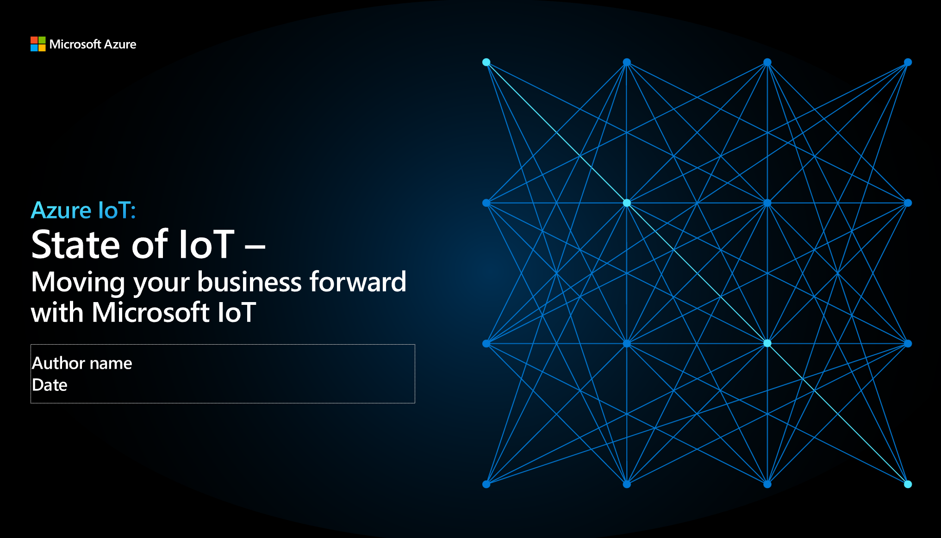
Morning Session: State of IoT
Standard deck for the first morning session
Recorded training on how to deliver this content
Includes:
Internet of Things overview
Industry insights based on the Signals Report
Key capabilities

Slide 16
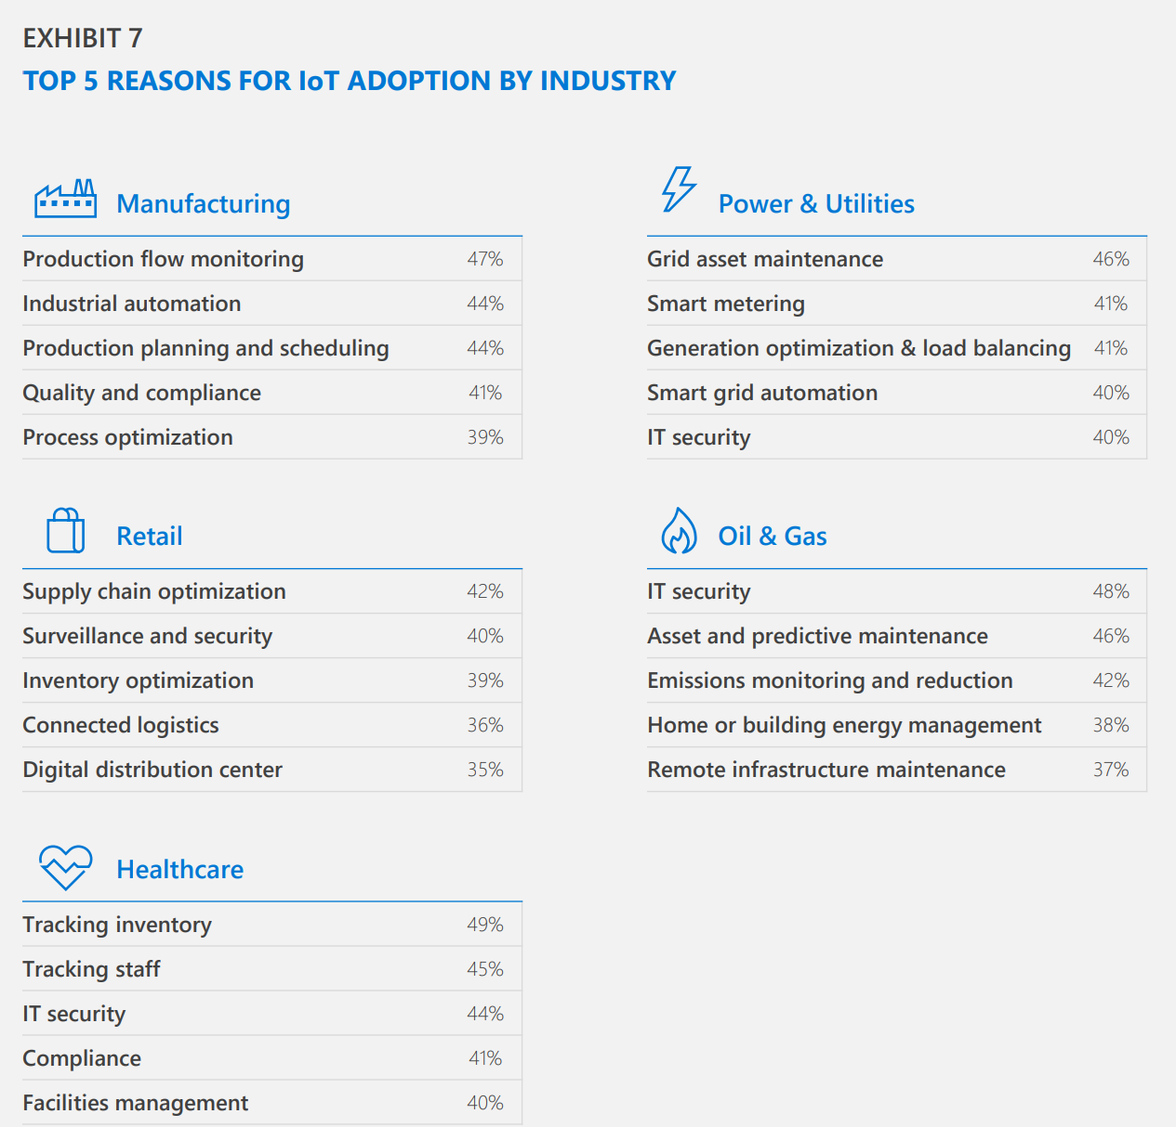
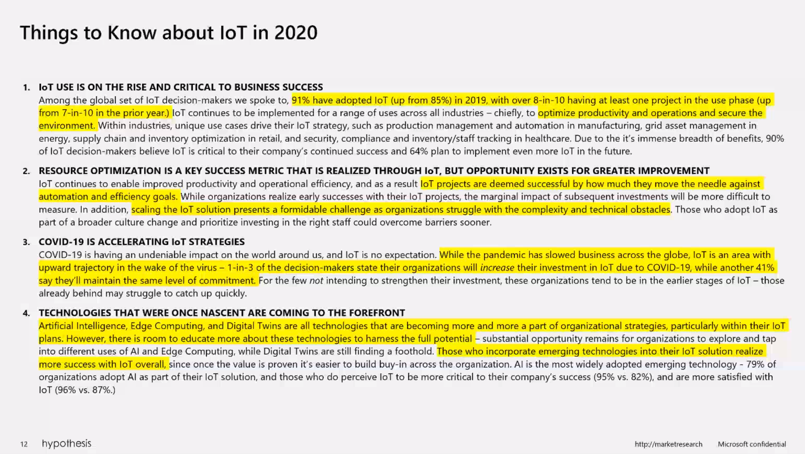
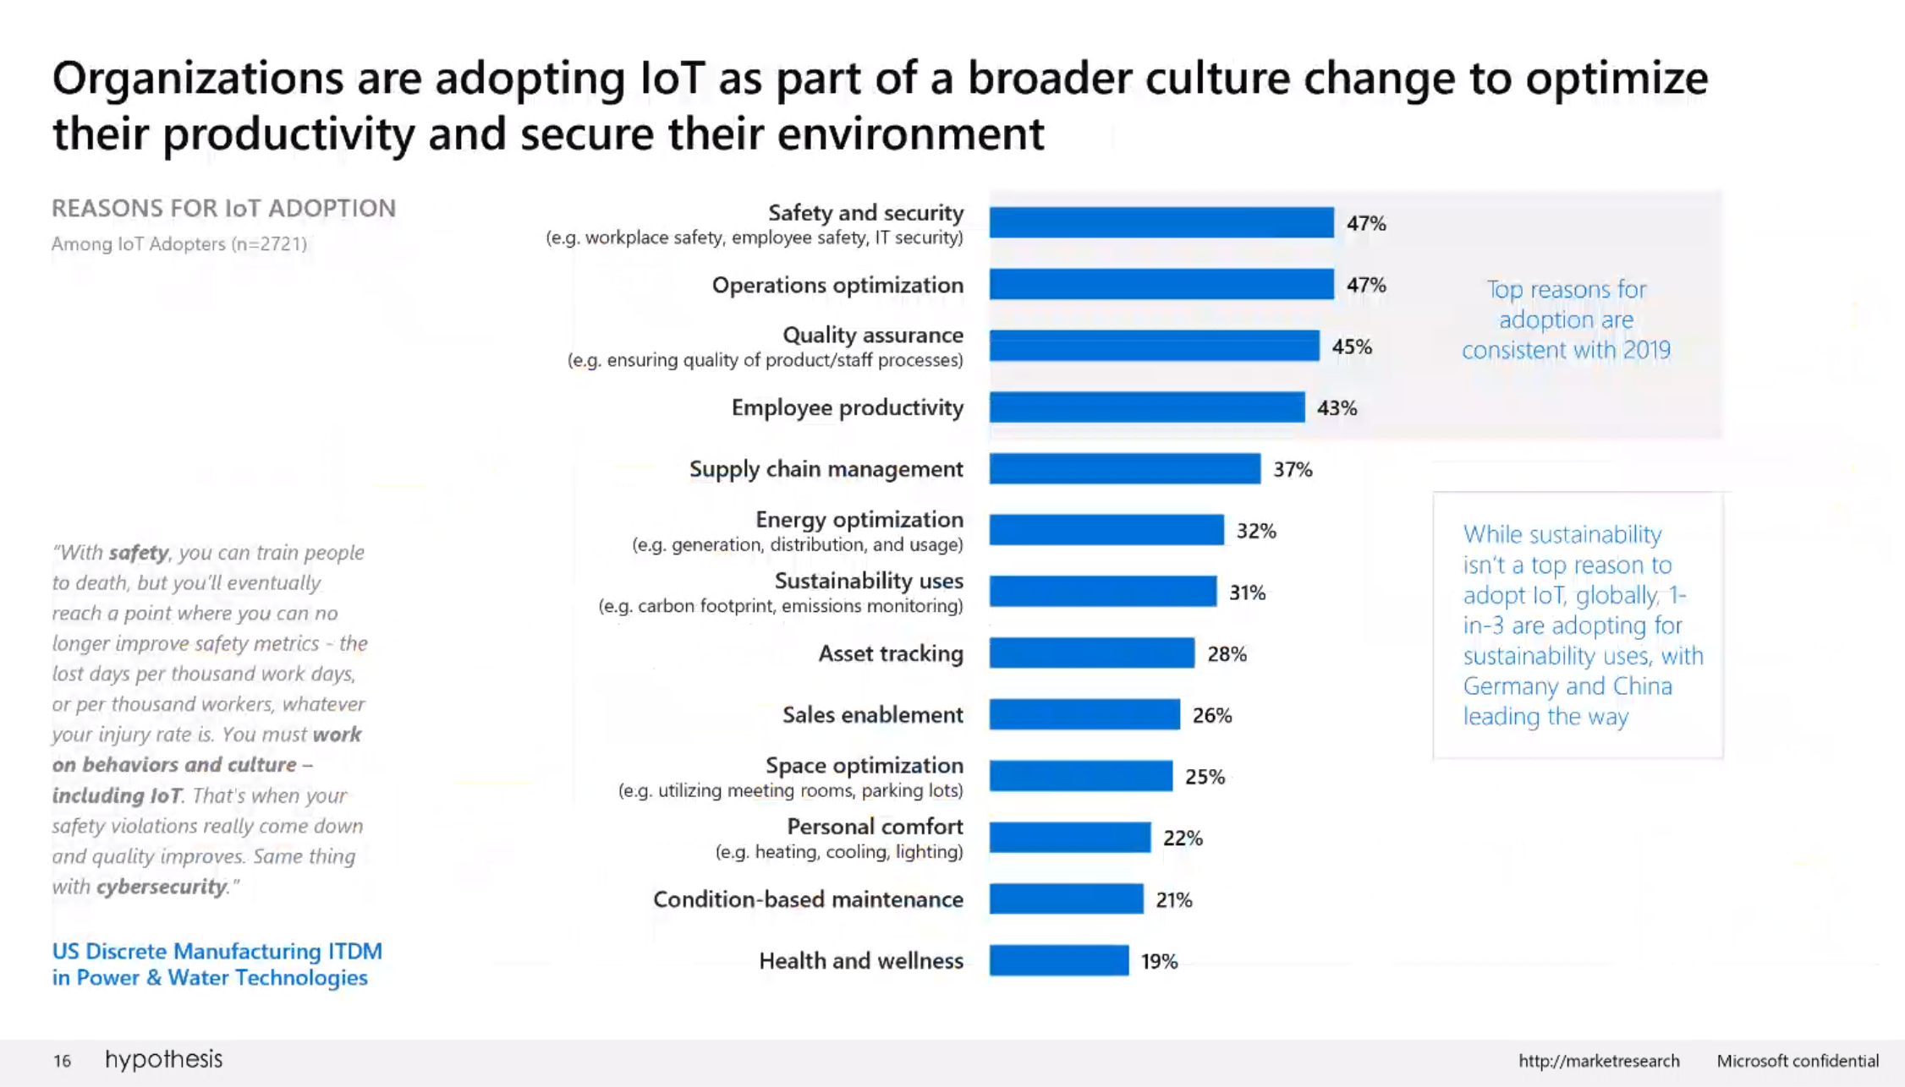
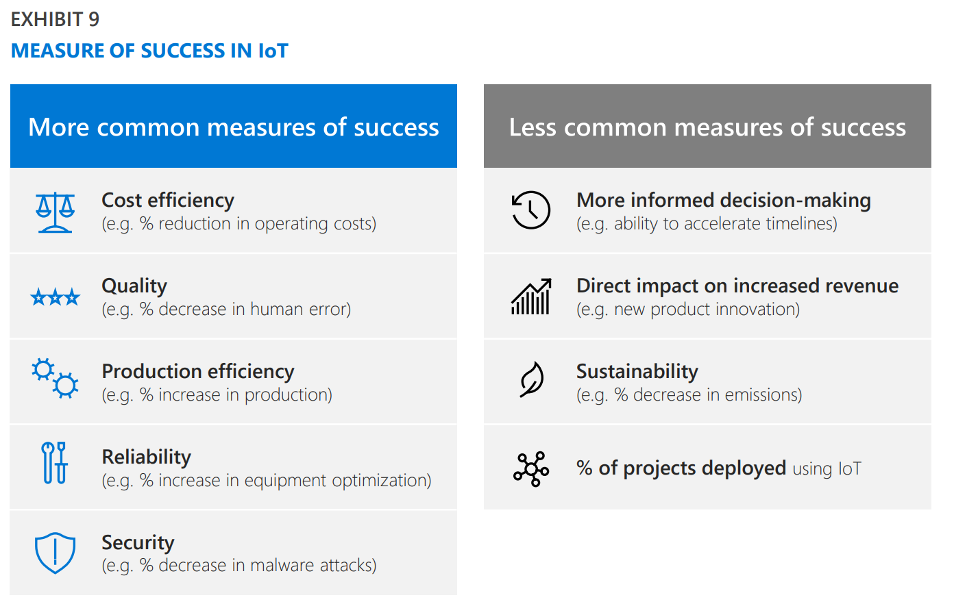
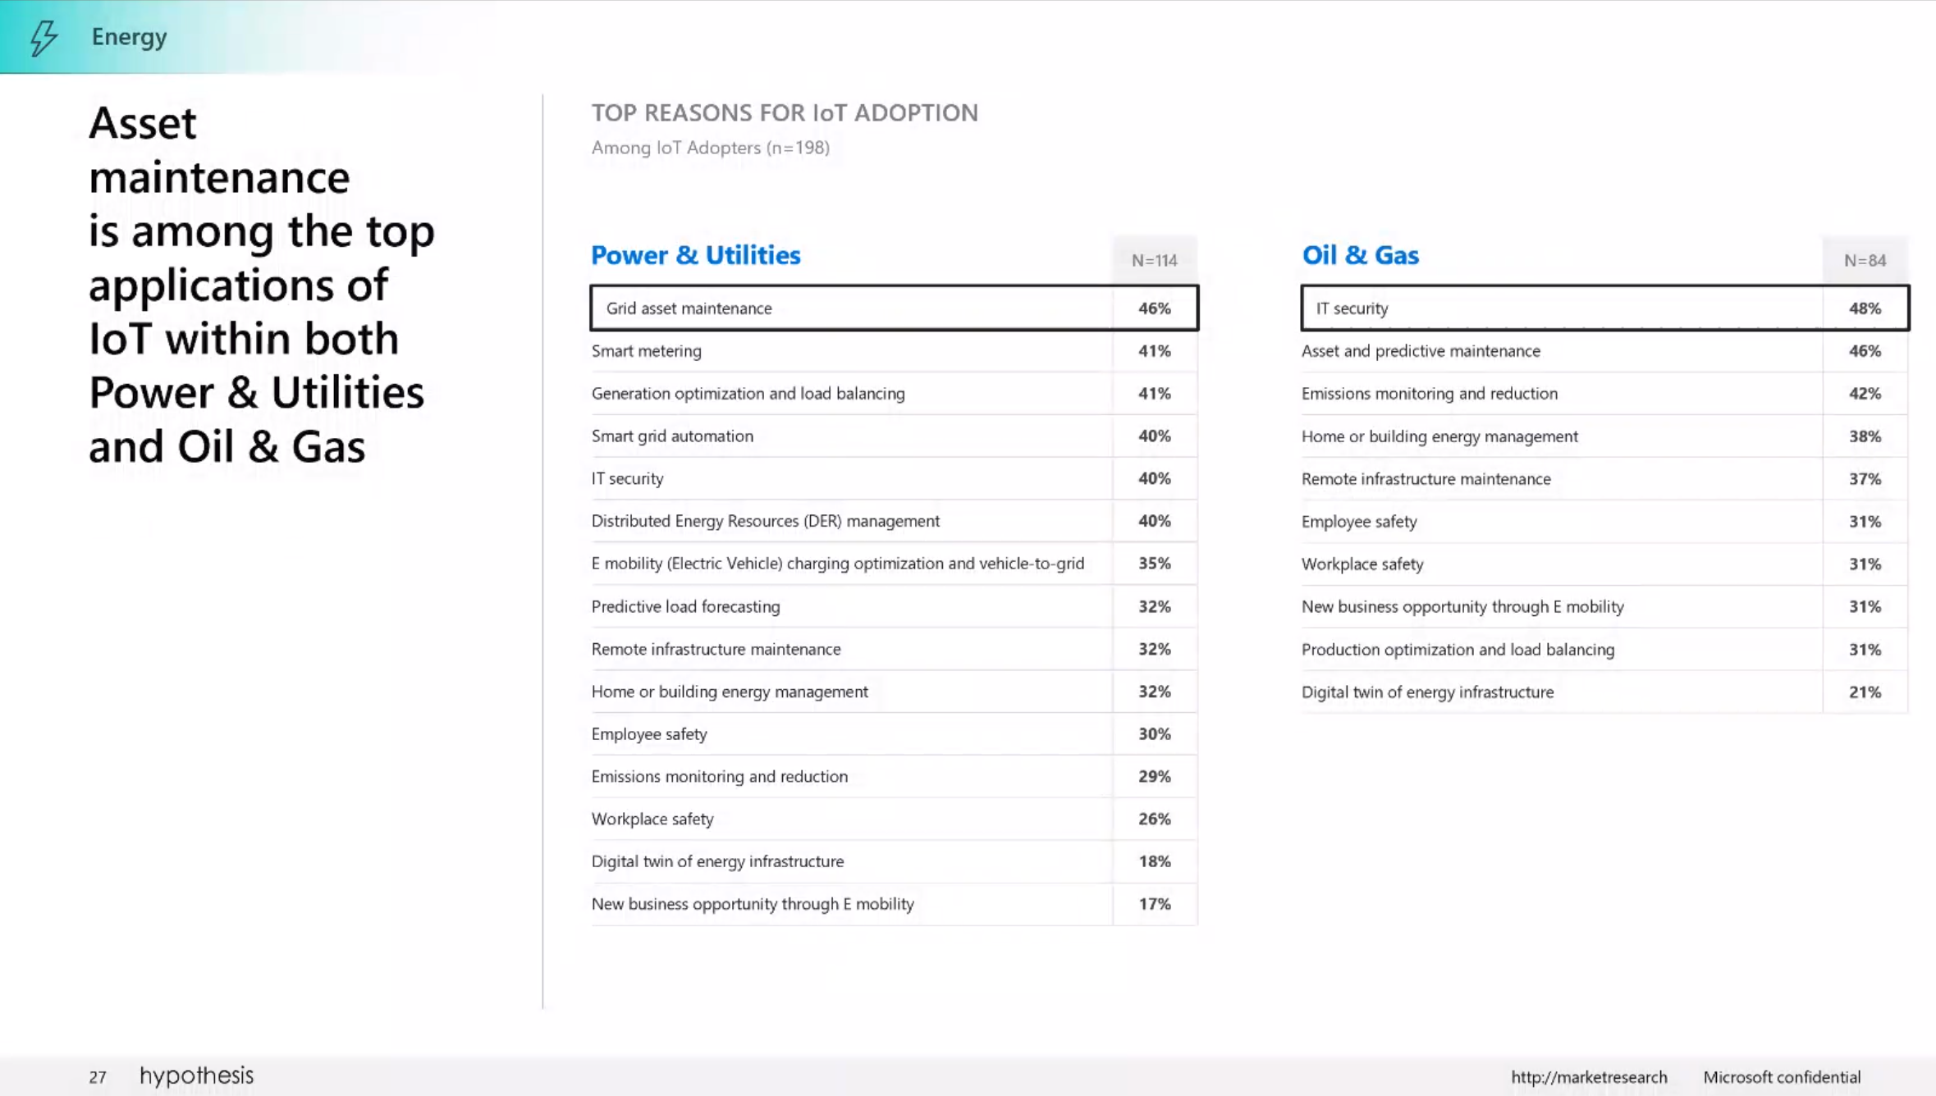
New Signals Report
Blog - https://azure.microsoft.com/en-us/blog/iot-signals-research-edition-2-global-insights-for-2020-and-beyond/
IoT industry survey done by Hypothesis
Published publicly in October
Notes:
Blog - https://azure.microsoft.com/en-us/blog/iot-signals-research-edition-2-global-insights-for-2020-and-beyond/
Download IoT Signals edition 2 - https://azure.microsoft.com/resources/iot-signals/
The IoT Signals Report is an annual report Microsoft does to better serve their partners and customers, as well as help business leaders develop their own IoT strategies. It's meant to spotlight IoT adoption, challenges, trends, and opportunities.
Download the report to see:
Key things to know about IoT in 2020
Insights, such as top reasons for IoT Adoption
Breakout details by Industry: Retail, Healthcare, Energy, Manufacturing
Trends by key technology areas: AI, IoT, Digital Twins

Slide 17
Azure IoT helps you transform your business
Quickly turn your vision into reality with secure, scalable, and open, edge-to-cloud IoT solutions
Develop with choice
Prepare for future innovation
Secure data everywhere
Power the Edge
Scale globally
Notes:
Azure IoT is a collection of Microsoft-managed cloud services that connect, monitor, and control billions of IoT assets. With it you can quickly turn your vision for a connected future into reality with secure, scalable, and complete, edge-to-cloud IoT solutions. We’ve broken down the platform into five primary pillars:
Develop with choice – [Azure IoT Hub, Azure IoT Central, Digital Twins]
Simple tools, simple templates, and simple open source. You can build open and flexible IoT solutions on your terms. Get leading device management, cloud integration and choice across fully managed applications or IoT platform services.
Prepare for future innovation [Azure Time Series Insights]
Innovation is a journey without end. You can build on a platform and with an ecosystem with a bold commitment to sustainability and continuously enhanced data, AI, and analytics solutions. Integrate into your existing systems, launch into new opportunities. There’s so much potential here.
Secure data everywhere [Azure Defender for IoT, Azure Sentinel, Azure Sphere]
With Azure IoT, you can trust your data estate is secured from endpoints to the cloud. That’s because we partner with the most proactive leader in IoT security with the largest portfolio of regulatory and compliance certifications in the industry.
Power the Edge [Azure IoT Edge]
Azure IoT lets you move your AI and business workloads to the edge. This lets you react with more agility, operate more reliably, and spend less time transmitting to the cloud.
Scale globally [Partner network, Azure Marketplace, Datacenters]
Scalability is always an important issue. With Azure IoT, you can unlock the largest IoT ecosystem global to scale, wherever and whenever you are ready to grow.
Microsoft dedicated to improving every facet of IoT for business, which is why it’s investing $5 billion to do just that.

Slide 18


Microsoft’s comprehensive IoT product portfolio
Azure IoT priority verticals
Manufacturing
Retail
Agriculture
Energy
Smart Places
Healthcare
Transportation
Azure IoT Central
Dynamics Connected Field Service and Connected Store
Azure IoT solutions
Azure Security
Center for IoT
Azure IoT Hub
Azure IoT Hub Device Provisioning Service
Azure Digital Twins
Azure Time Series Insights
Azure Maps
Azure Stream Analytics
Azure Cosmos DB
Azure AI
Azure Cognitive Services
Azure ML
Azure Logic Apps
Azure Active Directory
Azure Monitor
Azure DevOps
Power BI
Azure Data Share
Azure Spatial Anchors
Azure
Services for IoT
Azure RTOS
Azure Sphere
Azure IoT Device SDK
Azure IoT Edge
Azure Stack Edge
Windows IoT
Azure Certified for IoT—Device Catalog
Azure Stream Analytics
Azure Storage
Azure ML
Azure SQL
Azure Functions
Azure Cognitive Services
IoT & Edge
device support
Notes:
Microsoft has the industry-leading portfolio of services that help customers easily create IoT solutions spanning the intelligent cloud and edge based on their needs—from ready to use Software as a Service (SaaS) applications to custom solutions across device, cloud, and integration services.
Azure IoT is helping our customers make things happen at every level of their organization’s digital transformation by providing the most comprehensive portfolio for IoT from the edge to the cloud. You get enterprise-ready solutions, predictable costs and timelines, and the largest network of IoT partners across industry. You not only put your organization in position for evolution with improved efficiency and improved margins, but with advanced analytics and AI, Azure IoT puts your organization in position for revolution to disrupt, create new revenue streams, and stay ahead of the pack.

Slide 19
IoT Workshop Hand-on Labs
Pre-created Environment:
Azure IoT Hub
Azure Time Series Environment
Azure Stream Analytics
Simulated Devices on VM
Power BI Pro License
IoT Simulator App
Lab Instructions: https://github.com/SpektraSystems/IoT-in-a-Day/tree/master/instructions
Storage Account
IoT Edge enabled Linux VM
Blob Storage
Logic App
Service Bus
Azure IoT Explorer

Slide 20
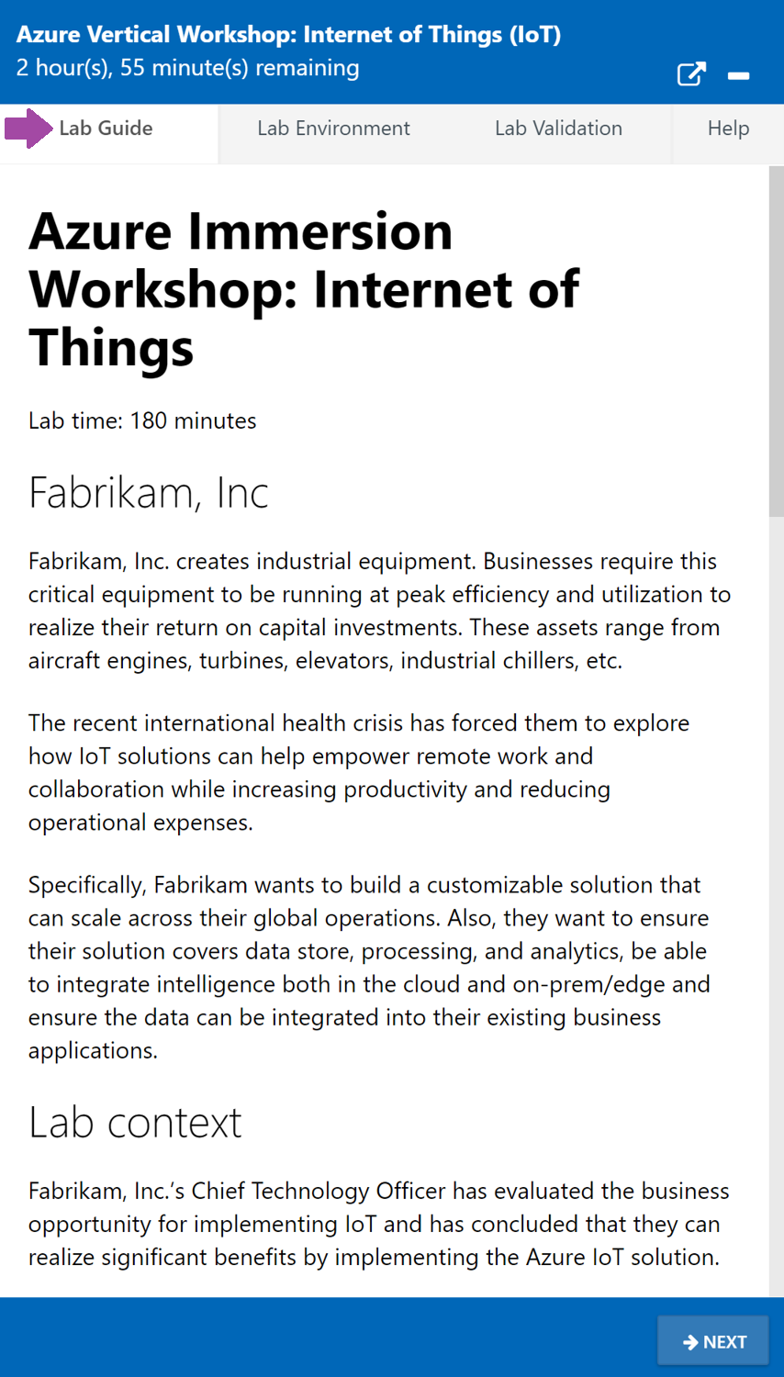
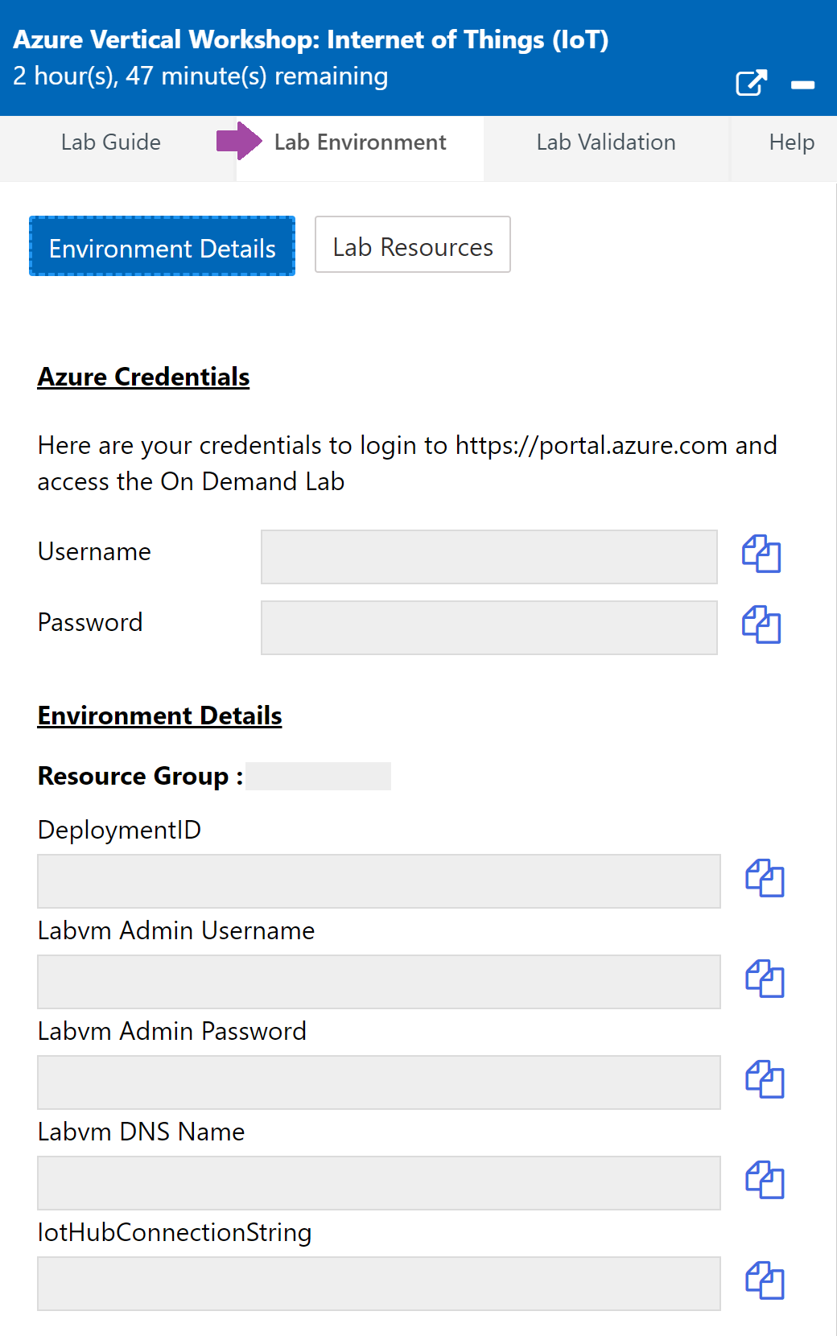
Hands-on Lab Exercises
Exercises:
Getting Started with Azure IoT Services
Processing Data from Azure IoT Hub
Machine Learning in IoT and Real-Time Monitoring using Power BI
Getting started with Azure IoT Edge
Securing the IoT Solution
Notes:
Exercise 1: Getting Started with Azure IoT Services
Scenario
Fabrikam, Inc.’s Turbines (devices) are deployed across the globe. You need to configure the Azure IoT Hub Solution to receive telemetry and manage all the devices centrally in a reliable and scalable fashion.
Overview
In this exercise, you will connect devices deployed across the globe to Azure IoT Hub and start sending telemetry data from turbine devices to Azure IoT Hub.
You will be performing the following activities to achieve the goal:
Login to Azure Portal and Verify pre-created Azure IoT Hub and other resources.
Register device (simulated) to Azure IoT Hub.
Enable device (simulated).
Send telemetry from devices to Azure IoT Hub
Review telemetry data stream from Azure IoT Hub IoT Explorer
Exercise 2: Processing Data from Azure IoT Hub Scenario
Fabrikam, Inc.’s team requires that all temperature data should be available for real-time consumption and analysis along with long term storage for historical analysis and data retention. Fabrikam’s management team requires data to be accessible in the forms of real-time dashboards and reports.
In order to achieve the requirements, you will need to store all data generated by Turbine devices in long-term storage for the cold path analysis and transform a subset of the telemetry data for real-time analysis. Additionally, You will also need to configure visualization on the hot path dataset using PowerBI and TSI Explorer.
Overview
In this exercise, you will use Stream Analytics to process and transform the data in IoT Hub. You will store all data in blob storage for Cold path analysis and filter a subset of the telemetry data for real-time analysis and visualization on the hot path in PowerBI.
This includes the following tasks:
Review Stream Analytics Job
Start Stream Analytics Job
Review data in blob storage using Storage Explorer
Visualize hot path data in PowerBI
View Time Series Insights Explorer
Exercise 3: Machine Learning in IoT and Real-Time Monitoring using Power BI
Scenario
Insights generated so far require manual involvement to detect anomalies. Fabrikam would want to make use of technological advancement in the field of AI(Artificial Intelligence) to detect anomalies in the temperature data. Fabrikam would also want to configure automated alerts in case of any anomaly detection and do real-time monitoring of the data streams with anomalies information.
You need to configure the solution to use Machine Learning to detect anomalies without any manual intervention. You also need to enable real-time monitoring of the data stream across multiple dimensions and configure alerts to notify your team whenever any anomalies are detected.
Overview
In this exercise, you will use automated in-built Machine Learning models to analyze the data from the Turbine devices and detect anomalies, and also you will use the output from the query in the previous exercise to visualize the real-time data in a Power BI dashboard.
This exercise includes the following tasks:
Triggering anomalies using IoT Simulator App
Detect Anomalies using built-in Machine Learning Model
Create a Power BI Dashboard and Visualize Anomaly Data
Configure alerts to notify whenever an anomaly is detected [Read-Only]
Exercise 4: Getting started with Azure IoT Edge
Scenario
With a huge number of deployments of devices, a large amount of data is being collected and send to the cloud. Is it possible to bring intelligence to the Edge?
Fabrikam, Inc. wants to use an IoT Edge gateway device to bring some of the intelligence to the edge for immediate processing. A portion of the data will still be sent to the cloud. Bringing data intelligence to the IoT Edge also ensures that they will be able to process data and react quickly even if the local network is poor.
You have been tasked with prototyping the Azure IoT Edge solution. To begin, you will deploy a Stream Analytics module to the device that will be used to calculate the average temperature and generate an alert notification if process control values are exceeded.
Overview
In this exercise, you will deploy a Stream Analytics module to the Edge device and generate an alert notification if process control values are exceeded. You are provided a pre-created Linux based Azure VM configured as an IoT Edge device for the purpose of this lab.
You will complete the following tasks as part of this exercise:
Connect to IoT Edge VM
Add an Edge Module to the Edge Device
Deploy Azure Stream Analytics Edge Module to the Edge Device
Exercise 5: Securing the IoT Solution
Scenario
With the IoT solution roll-out, CTO is concerned about the overall security, specifically around STRIDE threats (spoofing of user identity, tampering, repudiation, information disclosure, denial of service, the elevation of privilege).
How can you ensure that solution is secure end to end?
Overview
In this exercise, you will complete the following activities:
Enable Azure Security Center for IoT
Create a Security Module Twin
Install Security center Agent on a Linux Machine
Configure monitored resources
Create custom alerts
Review the alert in the Azure Security Center

Slide 21
Microsoft Accessibility Standards

Slide 22
Microsoft Accessibility Standard
In order to ensure you are consistently adhering to the most up-to-date accessibility standards for all events, please access the AKA link below:
http://aka.ms/eventsaccessibility

Slide 23
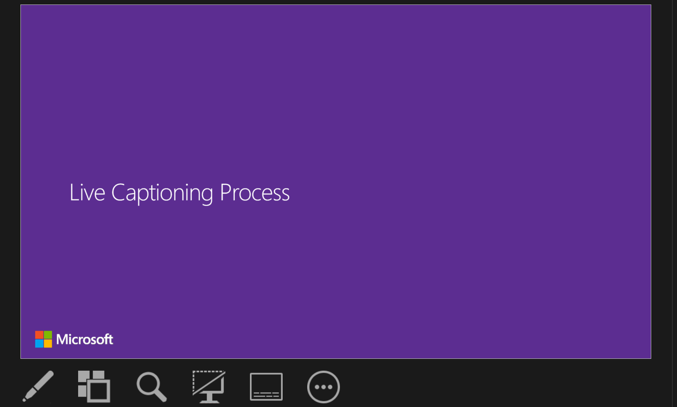
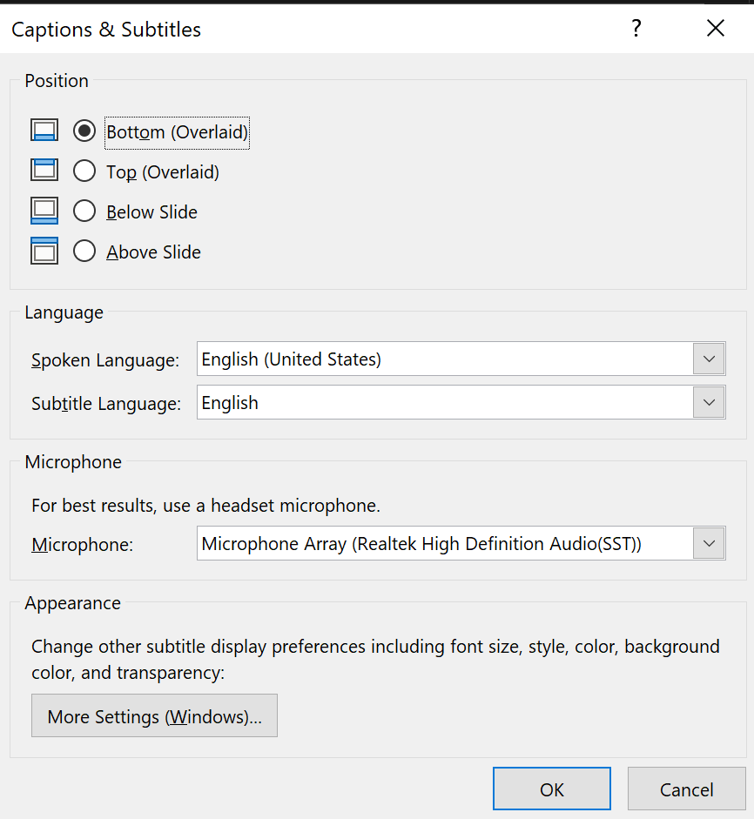
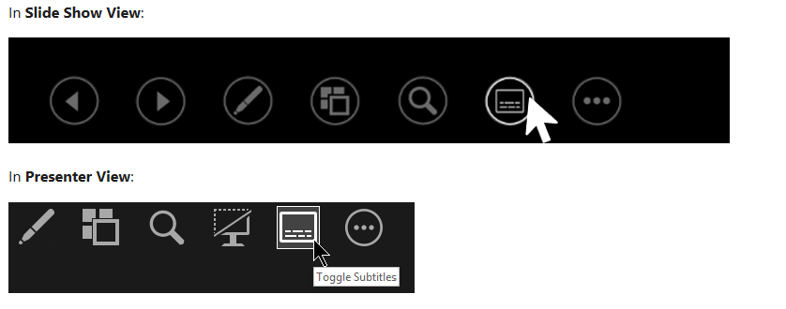

PowerPoint Captioning
Present with real-time, automated captions or subtitles in PowerPoint:
In Slide Show ribbon tab, select Subtitles Settings. Or, you can adjust the settings without leaving your presentation through the context menu, Slide Show or Presenter View menus> Subtitles Settings> More Settings.
Use Spoken Language by default, this will set the captions to the language you are speaking
Use Subtitle Language menu, set the desired position of captions or subtitles.
Spoken and on-screen supported languages
2
1
1
3
2
3
1
1

Slide 24
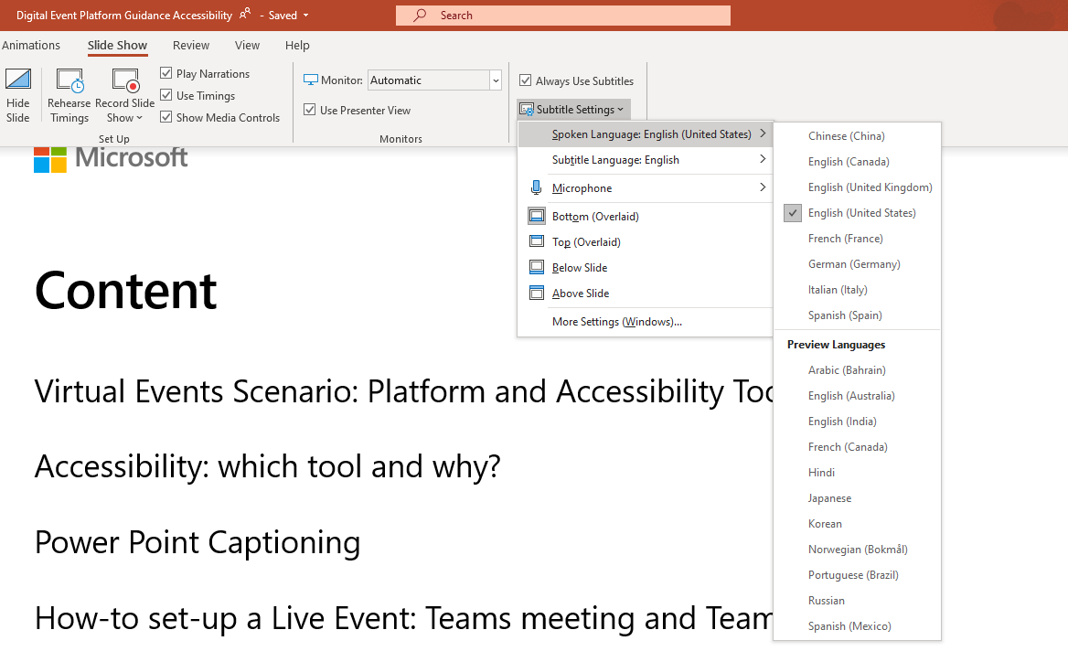
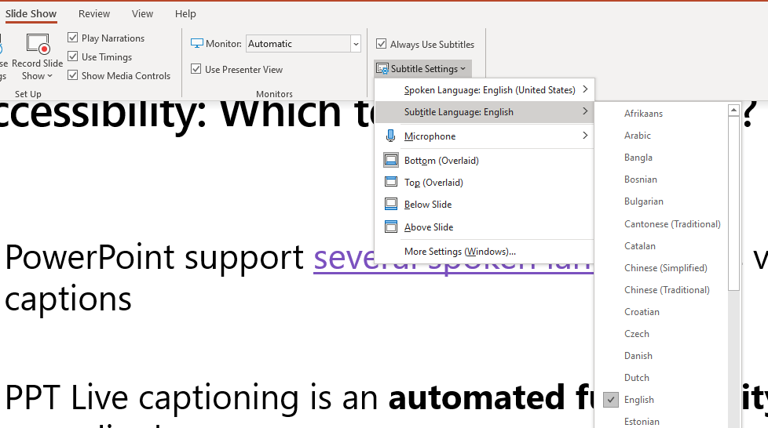
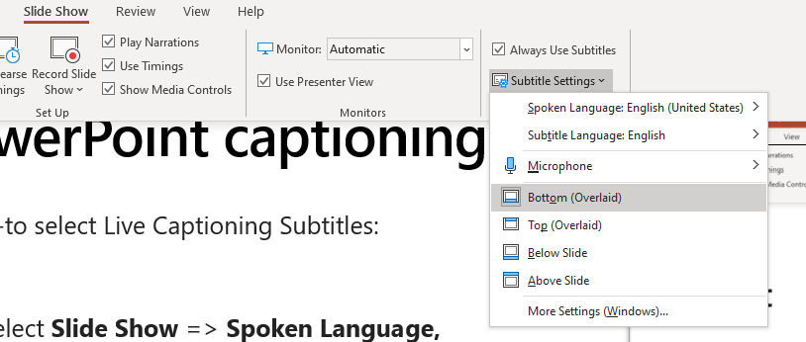

PowerPoint Captioning
1
How-to select Open Captioning in one spoken language with a same language for Subtitle:
Select Slide Show => Spoken Language, select the language that the presenter will be talking to during the Live Event.
Select Subtitle Language => Select the spoken Language
Select where the Live Captioning should appear during your Event. Four options are offered, select the adequate option that would not hide the slides.
Select the Microphone connected to your desktop
2
1
1
3
2
2
3
3
Select Below slide or Above slide to avoid hiding the content of the slide

Slide 25
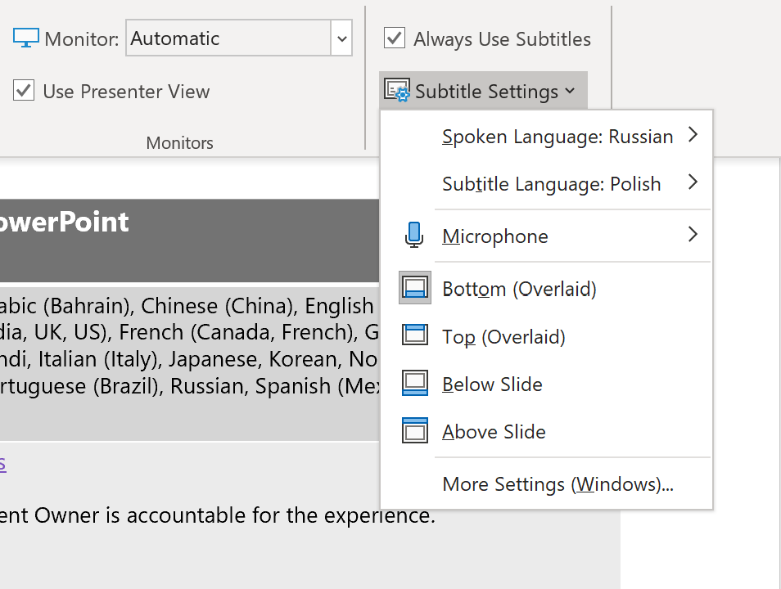
PowerPoint: Open captioning with Subtitle in Different Language
1
How-to select Open Captioning with Subtitle in a different language:
Select Slide Show => Subtitle Settings=> Spoken Language, select the language that the presenter will be talking to during the Live Event. On this example Russian is the Spoken language
Select Subtitle Language => Select a different language than the spoken one. On this example Polish is the Subtitle language.
Select where the Live Captioning should appear during your Live Event. Four options are offered, select the adequate option that would not hide the slides.
2
1
2
3
3

Slide 26
Logistics and Demand Generation
Marketing BOM
Demand Gen

Slide 27
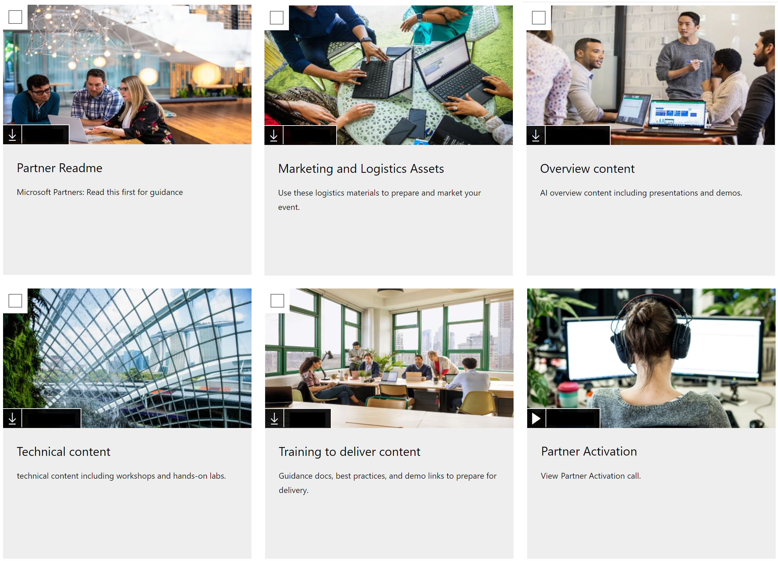
Workshop Assets: https://aka.ms/IoT-AVW

Slide 28
Next Steps
Execution Guidance
Action items

Slide 29
Event Execution & Roles
MSFT ROLES ■ Corp Program Owner: Azure Product Mktg Mgr.
■ A14 IoT PMM
■ OCP and Account Team
Scale Team
Partner ROLES ▲ Presenters, Proctors, Marketing
Lab Management
■ 3rd Party
PROGRAM DESIGN
LOCAL PLANNING
EVENT SET UP
LOCAL DEMAND GEN
DAY OF EVENT
ROLES
■ Program Owner Azure PMM | ■Event Blueprints, Overviews, Agendas, Content BOMs, Marketing BOMs, Measurement Plan, volume guidance, Localization Plan ■ Initial partner delivery candidates by geo and topic ■ Secure program and resource approval ■ Field readiness and landing plan ■ Program learnings, reporting and refinements/optimization | ■ Runs the local program v-team | ■ Sets up Reg Page ■ Initiates HOL request with Spektra via tool ■ Set-up Teams Link ■ Trains Partners on delivery of event and sets expectations for staffing requirements | ■ Lock/close registration at T-3 days (hard close) follow-up with AE’s ■ Tracks progress on each event |  | ■ Manages and maintains GDC Insights Events Dashboard ■ POE data reviewed and submitted for partner payment ■ Post event emails sent
■ IoT PMM |  | ■ Accountable for program in local market ■ Develops local calendar of events |  |  |  | BMW/ADS – customer review and plan
■ OCP and Account Team | ■ Identifies and nominates partners | ■ Invite amplification to targeted customers ■ Develops local calendar of events |  |  | ■ Attendee/moderator
■ 3rd Party |  |  | ■ Activate labs ■ Pre-event support |  | ■ Instant lab support through email / Teams | ■ Event completion confirmation ■ Environment cleanup
▲ Partner |  | ▲ Available for guidance | ▲ Provide logo, speakers, proctors, and join v-team prep calls | ▲ Send follow up oft invites and amplify program with their targeted accounts ▲ Executes and owns local demand generation plan | ▲ Ensures customers log in and speakers are ready to present and facilitate questions | ▲ Provides Proof Of Execution BMW/ADS next steps for customers
POST EVENT

Slide 30
Lab Process Overview
Spektra (pre-event)
Spektra
Setup Lab URLs a week ahead
Pre-event support
cloudlabs-support@spektrasystems.com
Event completion confirmation
Environment cleanup.
01
02
03
04
05
Microsoft
Spektra (during event)
Request lab from admin.cloudlabs.ai
Specify track, date, time, #seats
Associate instructors / proctors to request
Instant support through email / teams
Teams: http://bit.ly/cloudlabs-support

Slide 31

Call to Action
Please complete event feedback survey https://aka.ms/OCP-IoT-AzureVirtualWorkshopSurvey
Familiarize yourself with the Azure Virtual Workshop IoT track content https://aka.ms/IoT-AVW
Reach out to your respective IoT PMM to start planning for Azure Virtual Workshop – IoT events
AU - Valeriia Savenko Valeriia.Savenko@microsoft.com
Canada - TJ Walia TJ.Walia@microsoft.com
France - Christophe Borde Christophe.Borde@microsoft.com
GCR - Yi Qiu Yi.Qiu@microsoft.com
Germany - Thomas Frahler tfrahl@microsoft.com
India - Ruchi Tushir rutushir@microsoft.com
Japan - ​Akiko Kubota akikoset@microsoft.com
MEA - ​Steve Dunbar stdunbar@microsoft.com
UK - Alex Grimshaw Alex.Grimshaw@microsoft.com
USA - Lucio Tiberi Lucio.Tiberi@microsoft.com
WE - Aydin Gencler Aydin.Gencler@microsoft.com
IoT Signals Report https://azure.microsoft.com/en-us/resources/iot-signals/

Slide 32
PARTNERS are the heroes
that make this possible!
On behalf of Microsoft, THANK YOU for stepping up to be a delivery partner for IoT Azure Virtual Workshop events!
We know it’s an investment of time and resources, and we want you to know that WE COULD NOT DO THIS WITHOUT YOU!
Thank you for being the HERO to both Microsoft & our mutual customers!

Slide 33
Questions? Go to https://aka.ms/OCP-ImmersionWorkshops to learn more about this program and get your questions answered This group is part of the US Partner Community on Yammer, but is open to all partners. You will need to request to join this external network if you have not been there before.

Slide 34
© 2020 Microsoft Corporation. All rights reserved. Microsoft, Windows, and other product names are or may be registered trademarks and/or trademarks in the U.S. and/or other countries.
The information herein is for informational purposes only and represents the current view of Microsoft Corporation as of the date of this presentation. Because Microsoft must respond to changing market conditions, it should not be interpreted to be a commitment on the part of Microsoft, and Microsoft cannot guarantee the accuracy of any information provided after the date of this presentation. MICROSOFT MAKES NO WARRANTIES, EXPRESS, IMPLIED OR STATUTORY, AS TO THE INFORMATION IN THIS PRESENTATION.

